Slide 1
Designing for Performance
Basic design remained almost same , but each component were more sophisticated.

Slide 2
1. Microprocessor speed followed Moore’s law
From 746 KHz to 4 GHz
2 Branch prediction: The processor looks ahead in the instruction code fetched from memory and predicts which branches, or groups of instructions, are likely to be processed next.
3 Data flow analysis: The processor analyzes which instructions are dependent on each other’s results, or data, to create an optimized schedule of instructions.
4 Speculative execution: Using branch prediction and data flow analysis, some processors speculatively execute instructions ahead of their actual appearance in the program execution, holding the results in temporary locations

Slide 3
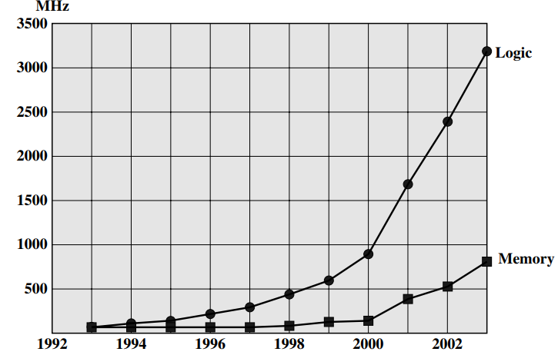
One bottleneck is
Speed mismatch between processor & memory
Tackled by wide bus length, high speed bus & caches

Slide 4
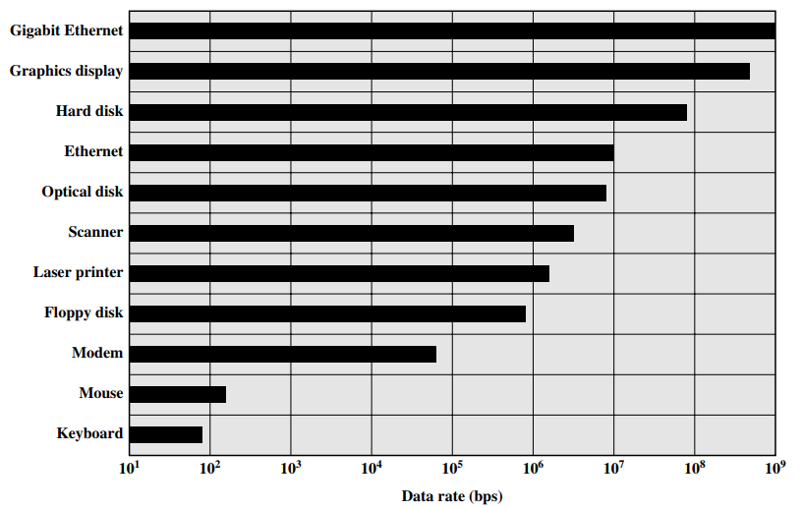
Similar bottleneck is speed gap between processor & IO devices
Solutions: caching and buffering schemes ,use of higher-speed interconnection buses and more elaborate structures of buses. the use of multiple-processor configurations

Slide 5
The key in all this is balance.
Designers constantly strive to balance the throughput and processing demands of the processor components, main memory, I/O devices, and the interconnection structures.
This design must constantly cope with two constantly evolving factors: • The rate at which performance is changing in the various technology areas (processor, buses, memory, peripherals) differs greatly from one type of element to another. • New applications and new peripheral devices constantly change the nature of the demand on the system in terms of typical instruction profile and the data access patterns.
Thus, computer design is a constantly evolving

